Slide 1
Outlook Tips & Tricks
August 2023

Slide 2
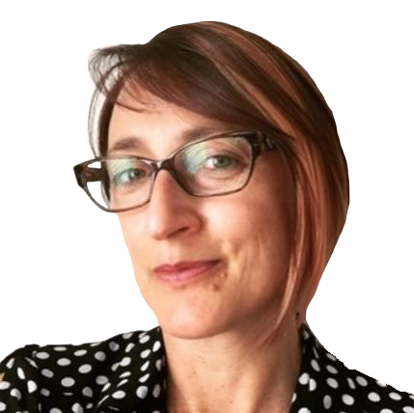
Christa Morrison
Business Systems Specialist
Chanel Morrison
B.Sc Honours Biology
4th year undergraduate
Sobia Khan
Systems and Technology
Masters in Engineering
Paul Duan (Xianzhao)
Computer Science (Co-op)
3rd year undergraduate

Slide 3
This session will include a look at:
Conversation View & Search
Focused/other inbox & Rules
Work hours and Location
Scheduling Poll (FindTime)
Create a poll in Outlook
Scheduling Assistant
Quick steps
Sweep (Inbox Clean Up)
Schedule Send
Bookings with Me
Notes:
We would like to give you an overview of what we will bring to you in this 30 mins
If you have any questions please feel free to ask in the chat, we can try and answer them at the end of the session

Slide 4
Conversation View & Search

Slide 5
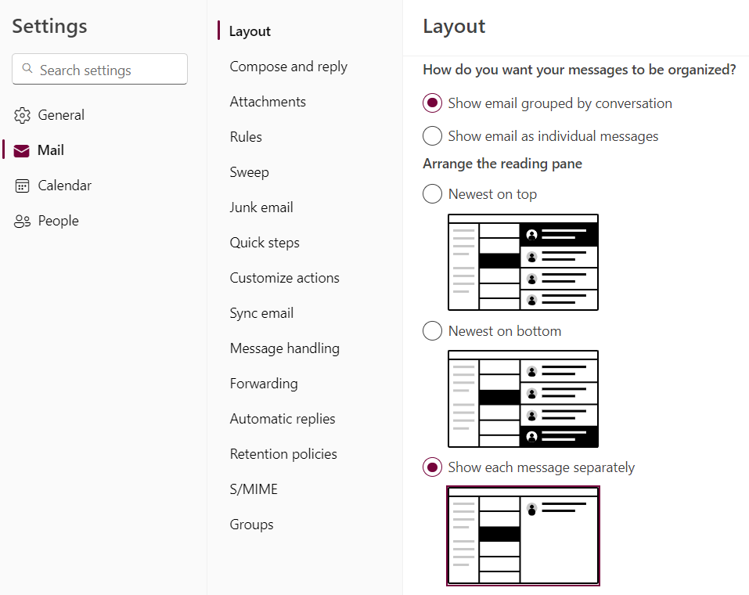
Conversation View
How to configure on Conversation View in Outlook
Sign in Outlook Web
Click on Settings
Choose Mail tab
Choose Layout sub-tab
Notes:
So, what is conversation view, I think most of us here have already using conversation view in their outlook, a conversation includes all messages in the same thread with the same subject line. In another word, all your back-and-forth emails are grouped together. So how to configure conversation view in outlook?

Slide 6
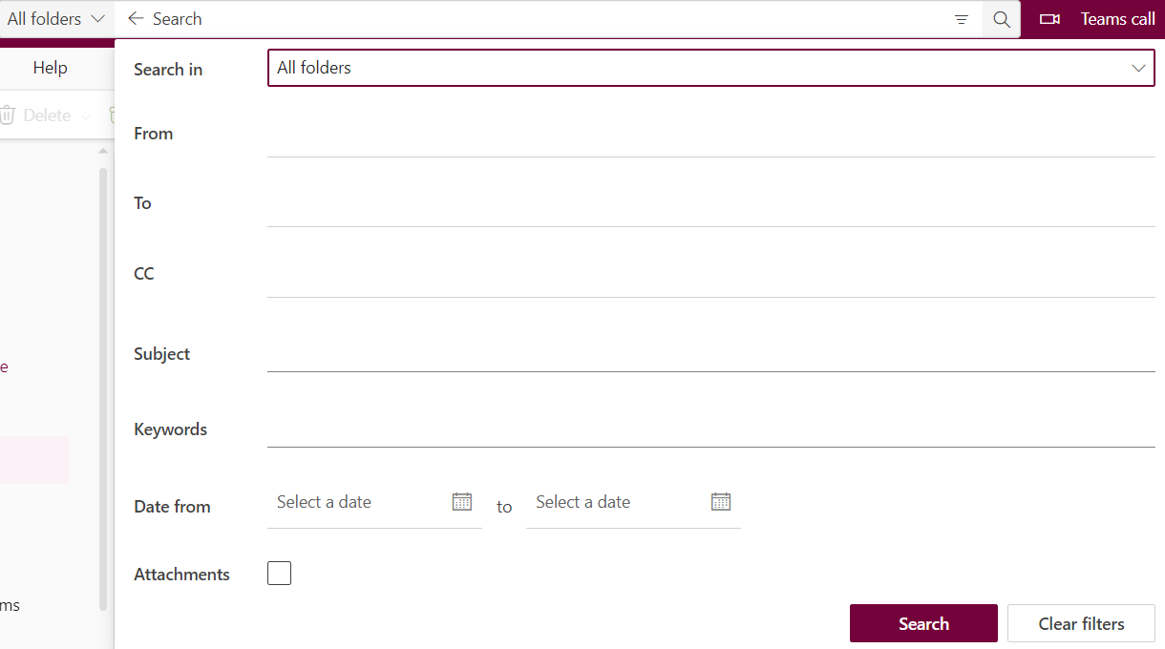
Optimize the Search in Outlook Web
Notes:
This feature will only take me 10 seconds to introduce to you, but this one will really save your time, when you

Slide 7
Focused and Other Inbox

Slide 8
Focused/Other Inbox
How to turn on Focused Inbox in Outlook
Sign in Outlook Web
Click on Settings
Choose Mail tab
Choose Layout sub-tab
Notes:
The Focused category contains emails that Outlook deems most important based on your frequent interactions and key contacts. These could be work-related emails, important notifications, or personal correspondences.
The Other category is for less critical emails, which often include automated messages, newsletters, promotions, and other bulk emails. This distinction helps to declutter your inbox, ensuring that your most crucial messages are always in your direct line of sight.
Make sure you train you inbox

Slide 9
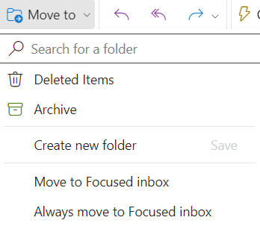
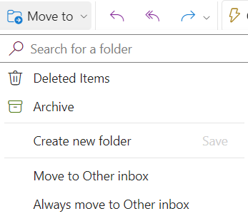
Focused/Other Inbox
How to train Focused/Other Inbox
Right click on the message that you would like to move
Select Move to Focused inbox/Move to Other inbox
Select Always move to Focused inbox/Always move to Other inbox
Notes:
To change which inbox specific emails come into, you can “train” Outlook. Right click on the message that you would like to move, and select “move to focused” or “move to other” if you only want to move one message. Select “Always move to Focused” or “Always move to other” if you want all future messages from the sender to be in the focused or other tab.

Slide 10
Rules

Slide 11
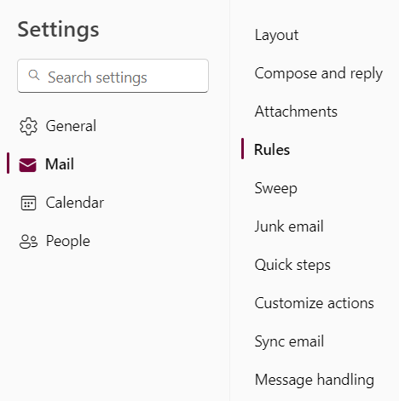
Rules
How to set up Rules in Outlook Web
Sign in Outlook Web
Click on Settings
Choose Mail tab
Choose Rules sub-tab
Notes:
You can create rules that tell Outlook how to handle incoming email messages.

Slide 12
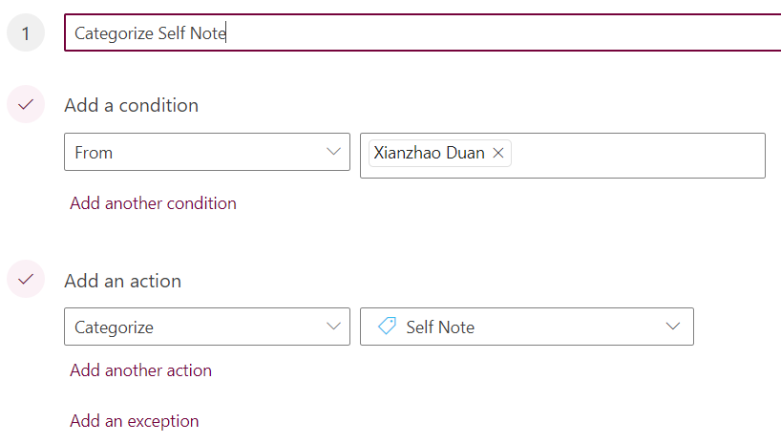
Rules
A Rule consists of 3 components
Conditions
From
To
I’m on the To line
I’m on the Cc line
Subject includes
Message includes
…
Actions
Move to
Copy to
Delete
Mark as read
Categorize
…
Exceptions

Slide 13
Work Hours and Location

Slide 14
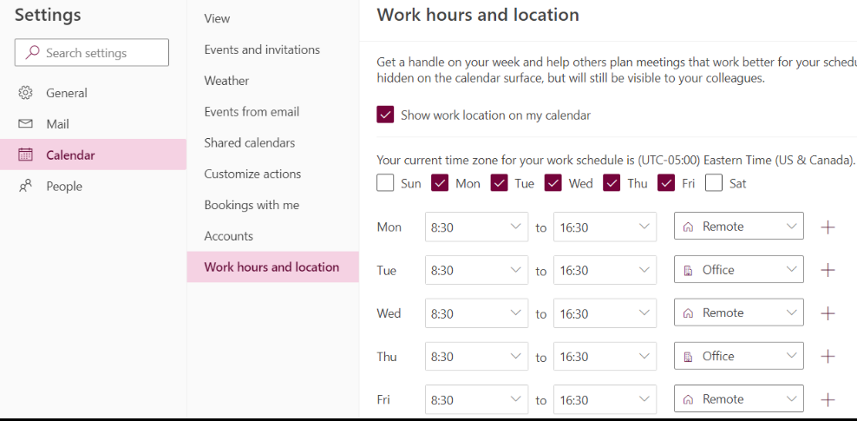
Work Hours and Location
How to set Work Hours and Location in Outlook
Sign in on Outlook Web
Click on Settings
Choose Calendar tab
Choose Work Hours and Location sub-tab
Notes:
Work hours and location is a handy feature that Microsoft provide with. This will save time, when you indicate when your location and work time, so the others can easiIy book event/meetings with you in the way they want. It will be useful since we are working in a hybrid environment, Work hours and Location allows you set your work hours for every day as well as your working location.

Slide 15
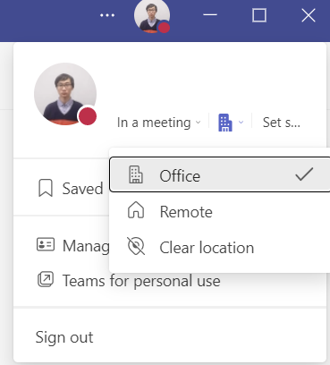
Work Hours and Location
How to update Location in Teams
Select the circle icon with your profile picture and change the work location.
*The new location will be applied for the remainder of the day and reflected in both Outlook and Teams.

Slide 16
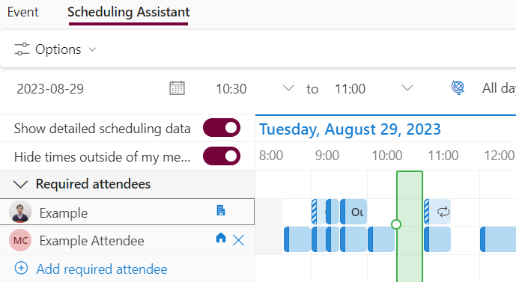
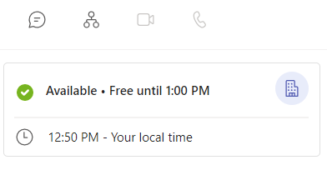
Work Hours and Location
How to view other’s locations
When you scheduling a meeting from Outlook their work location will appear in Scheduling Assistant
You could also view their profile cards in Teams to check their working location

Slide 17
Scheduling Poll (FindTime)
Notes:
Paul

Slide 18
Using Scheduling Poll (FindTime)
Create a New Email, make sure you add attendees
Select Scheduling Poll (FindTime)
Select the date, you will be able to get a preview according to the attendee's availability
Notes:
Paul: Scheduling poll is a feature for scheduling meetings
The organizer can send multiple time options through Scheduling poll and minimize the back-and-forth emails in scheduling
create a new email, and add recipients which will be your attendees, then select scheduling poll under Message tab(if you can not find, you could click the three dots). After this select the date, and meetings duration, you will be able to get a preview according to the attendee’s availability

Slide 19
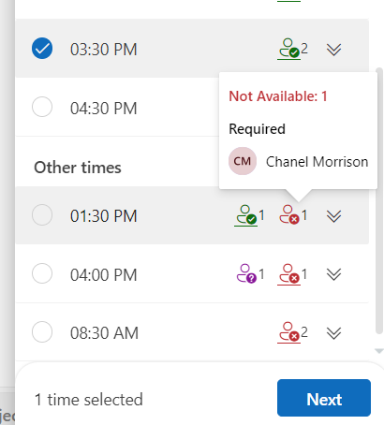
Using Scheduling Poll (FindTime) Contd.
You can see a preview of people’s availability during a timeslot
By hovering over people icon to the right you can see the specific people that may or may not be available
Select multiple time slots from this to be included in the poll
Notes:
Paul: By hovering over people icon to the right you can see the specific people that may or may not be available, you could select multiple time slots from this to be included in the poll

Slide 20
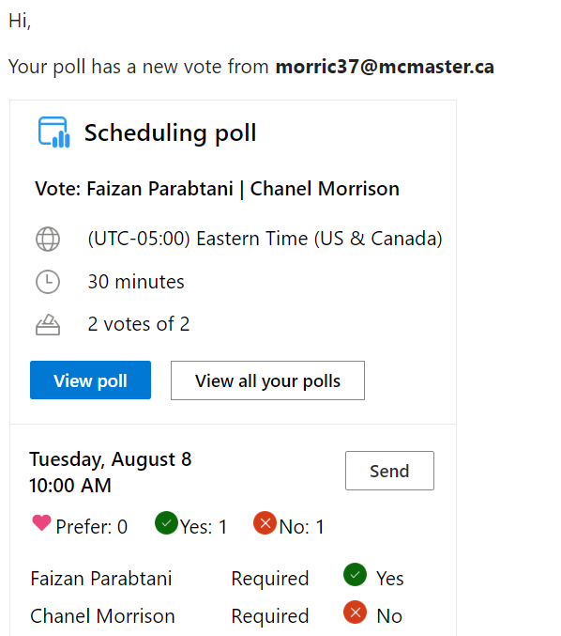
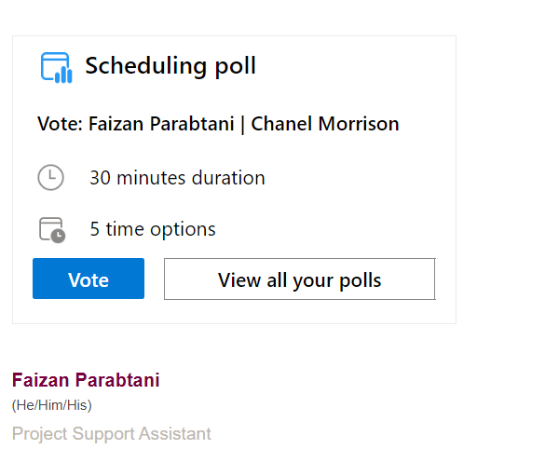
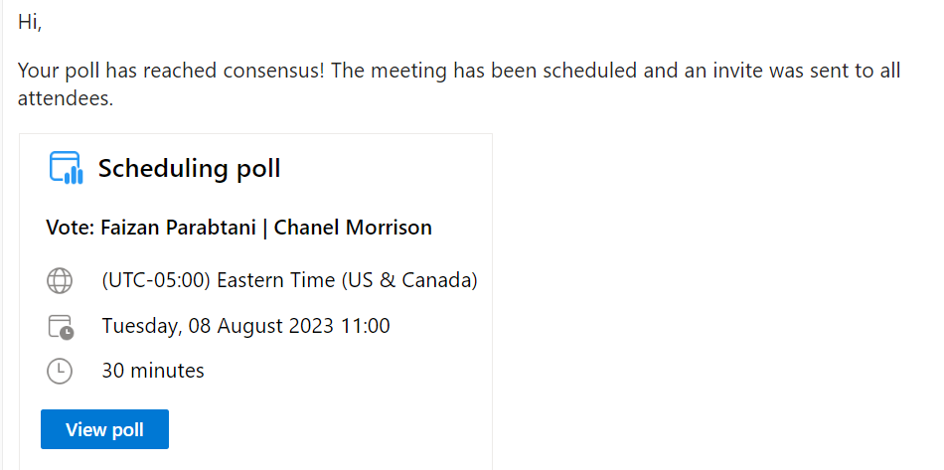
Sending meeting time preferences
Notes:
Paul: here is a view of scheduling poll that attendees will receive in their email, and you could schedule the meeting directly based on the result of the polls
Handing over to Sobia

Slide 21
Create a Poll in Outlook
Notes:
Now I am going to show how you can create a poll

Slide 22
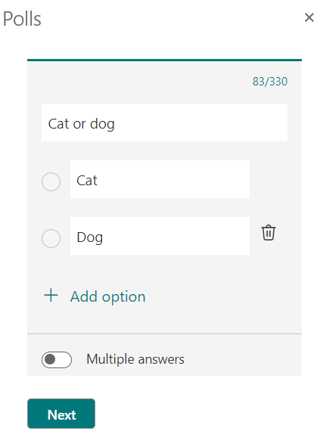
Create a poll in Outlook
Click on New email
Click on Insert -> Poll
Add your questions and click on Next
Notes:
In the Home tab, you can find "New Email". Once you are now composing your email, Click on the Insert tab, under that you can find Poll. So go ahead and click on Poll. I will open a section on the right hand side of where you are composing your email. This section is where you can add your questions and click on Next

Slide 23
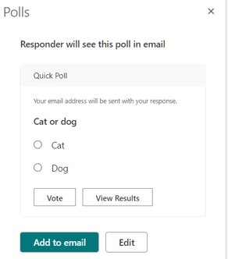
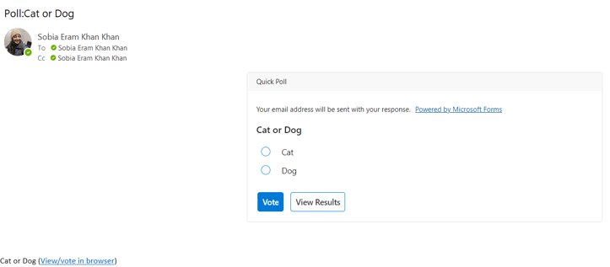
Create a poll in outlook
4. Click on Add to Email
5. Click on Send
This is how the email will look after sending
Notes:
After than you can click on Add to Email, and you can see the Poll is inserted in your email.
Just click on send. The right image is an example of how the Poll will look in an email. You can also view the results from there.

Slide 24
Scheduling Assistant
Notes:
Scheduling a 30-minute meeting shouldn’t require a dozen emails back and forth. Rather than all your meeting participants listing their availabilities for the week, use the Scheduling Assistant for a quick, overall view of your schedules. You can also see if the participants will be working from home or office. Let me show you how to use scheduling assistant.

Slide 25
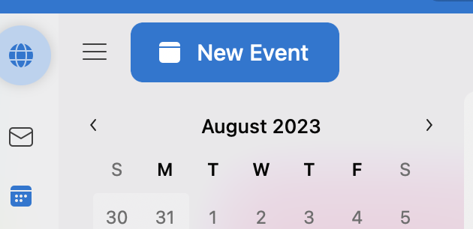
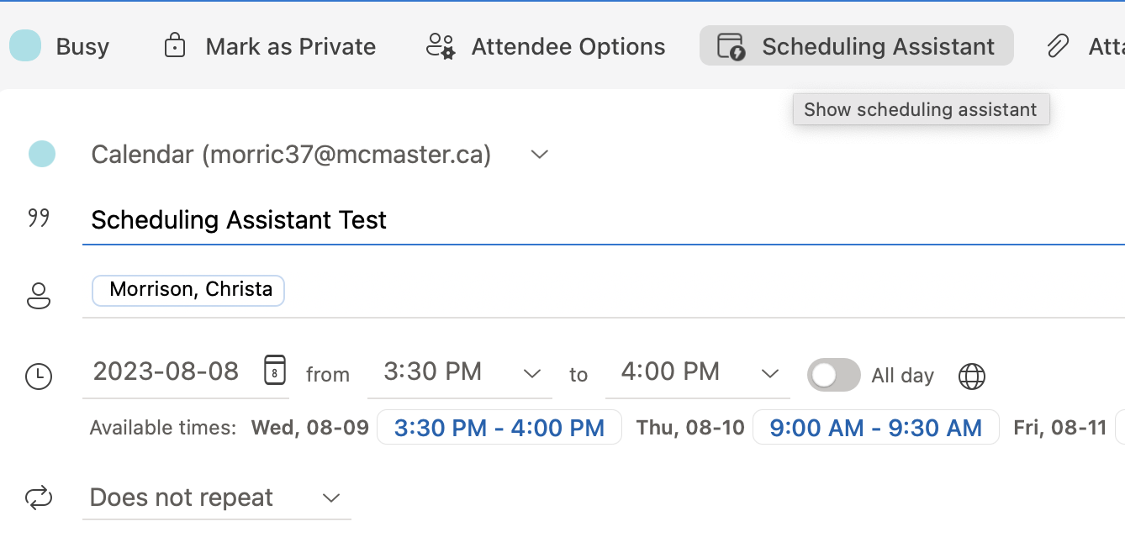
Scheduling assistant
Open your Calendar, then select New Event
Enter in your desired meeting information (name, attendees, date)
Select Scheduling Assistant
Notes:
To use scheduling send in Outlook, you will start by opening your calendar and then selecting new event or mail. Then once you’ve entered in all your meeting information (name, attendees, date), you will select scheduling assistant tab.

Slide 26
Scheduling assistant
4. By moving the vertical bar, find a time when all attendees are available
5. Select Done
Notes:
Now that scheduling assistant is open, you will move the vertical bar from left to right until you find a time when all attendees are available. You can also see where the attendees are working from (Home or office). Finally, you will select Done to send your meeting invitation.

Slide 27
Quick Steps
Notes:
What is Quick Steps? It apply multiple actions at the same time to email messages. This helps you quickly manage your mailbox. Now, you can create your own quick steps and decide how you want to manage the emails. Let me show you how you can do that

Slide 28
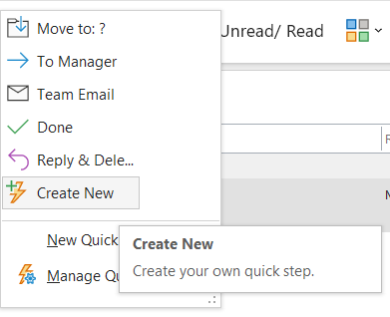
Create a Quick Step
In Home tab, Click on the dropdown Move to
Click on Create New
Notes:
In the Home tab, click on the dropdown menu of Move to, this will open up a few options for you. Click on Create New, and it will open a window. If you aren't able to find quick steps, you could always use the search bar in outlook, and type in Quick steps. It will also open up the same window for you.

Slide 29
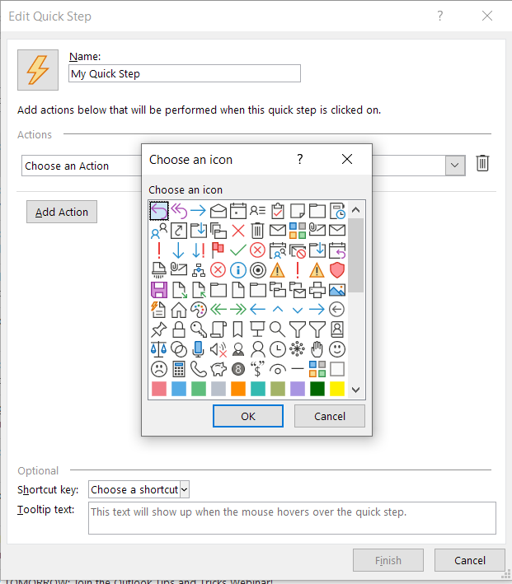
Create a Quick Step
3. Enter a name to you Quick Steps.
4. Click on the lightning Icon, and
Choose your Icon
5. Add actions
6. Click on Finish
More Information here
Notes:
Once this window is opened, you can enter a name to your quick steps. By clicking on the Icon next to the name, you can change the Icon to whatever best fits.
Click on add actions. The actions can be based on what you would like to do.
For example, if you frequently move messages to a specific folder, you can use a Quick Step to move the messages in one click. Or, if you forward messages to your manager or peers, a one-click Quick Step can simplify the task.
Once you are done creating, click on finish and it will be saved.
Handing over to Chanel

Slide 30
Sweep
Notes:
Thank you Sobia

Slide 31
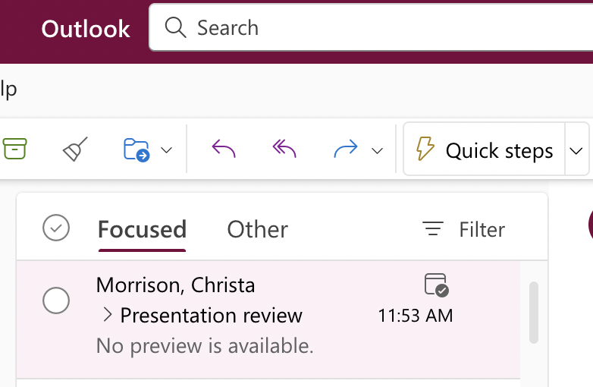
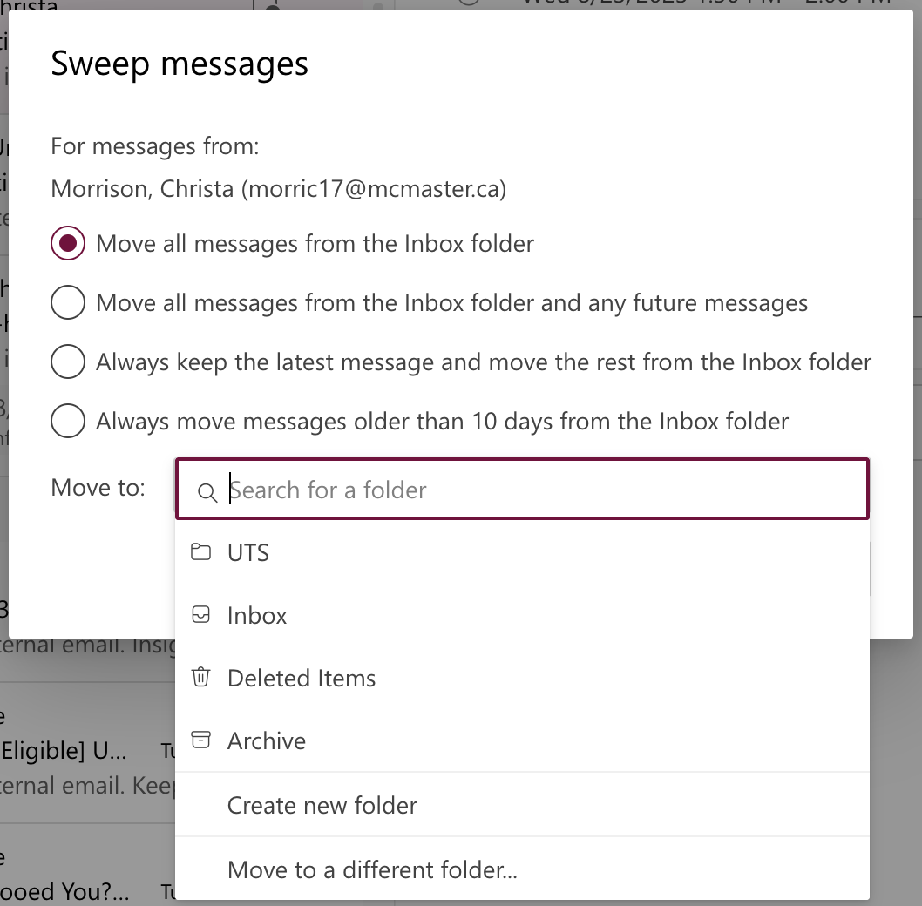
Sweep
Sweep can quickly move or delete unwanted emails in your Inbox.
1. On the tool bar, select Sweep.
2. Choose how you want to handle email messages from the sender you chose.
3. Select OK to perform the selected action.
Notes:
Chanel:
Sweep is a great feature in Outlook that you can use to quickly move a lot of emails or to delete unwanted emails from your inbox, allow you to prevent your inbox from clogging up. Sweep gives you options to automatically delete all incoming email from a particular sender, to keep only the latest email, or to delete email older than 10 days.
To use this feature, users must select an email from the sender whose messages you want to apply sweep rules on. On the upper tool bar, select Sweep then choose how you would like to handle email messages coming in from the sender. Finally, select OK to perform the selected action.

Slide 32
Sweep
Use Cases:
Option 1: Always keep the latest message and move the rest from the Inbox folder
Useful for dealing with reminder emails (ex. Regular alert messages)
Option 2: Move all messages from the Inbox folder
Useful to delete everything from your inbox (move messages to Deleted Items= INBOX CLEAN UP)
Can be used to categorize emails from a specific project/institution (move messages to new folder that you have created)
Notes:
Chanel:
Now I’d like to go over 2 different use cases for when Sweep would be a great tool to help manage your workload. So firstly, users could use the option that always keeps the latest message and moves the rest from their inbox folder when dealing with reminder emails such as regular alert messages. So, as the name implies, if you receive a regular reminder email every Monday, you can turn on this sweep rule to move all past reminders to a separate folder and then only keep the latest reminder email in your inbox.
The second option for moving all messages from the inbox folder can be used to either delete everything from your inbox by moving it to deleted items or can be used to categorize emails from a specific project/institution by creating a new folder and moving all the messages that come from that institution/project there.

Slide 33
Scheduled Send
Notes:
The next feature I will be talking about now not only allows you to prepare and send messages at a future time but it also helps make sure that we communicate with our colleagues only during work hours.

Slide 34
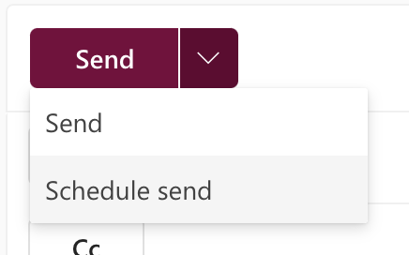
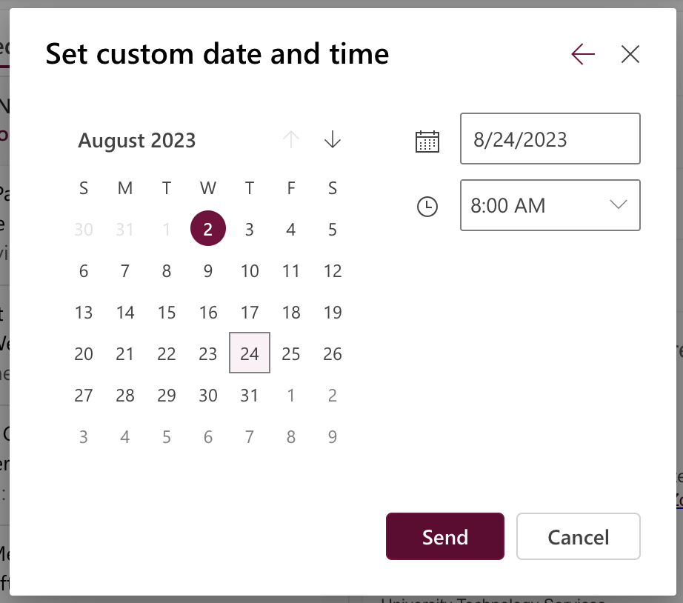
Scheduled Send
To send an email, select the drop-down arrow next to send and click on Schedule send
Select the time and date you'd like your email to be sent
Select Send
Notes:
To use this feature, users will open up a new email message in Outlook and then enter in all their desired information (including the name of the person you would to send this email to, the subject, and their email details). Now, instead of pressing send which will send their email instantly, users must select the drop-down arrow next to send and click on Schedule send. The schedule send pop-up will now appear, and users can then select the time and date they would like the email to be sent at. Finally, users will select send and the email you have created will now be sent at that given time and date that you have selected.
You can also use this in Teams.

Slide 35
Bookings with Me
Notes:
Chanel

Slide 36
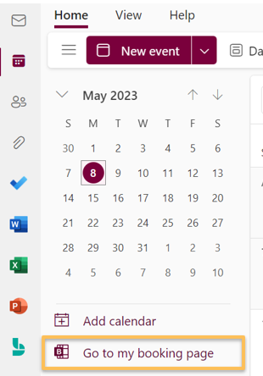
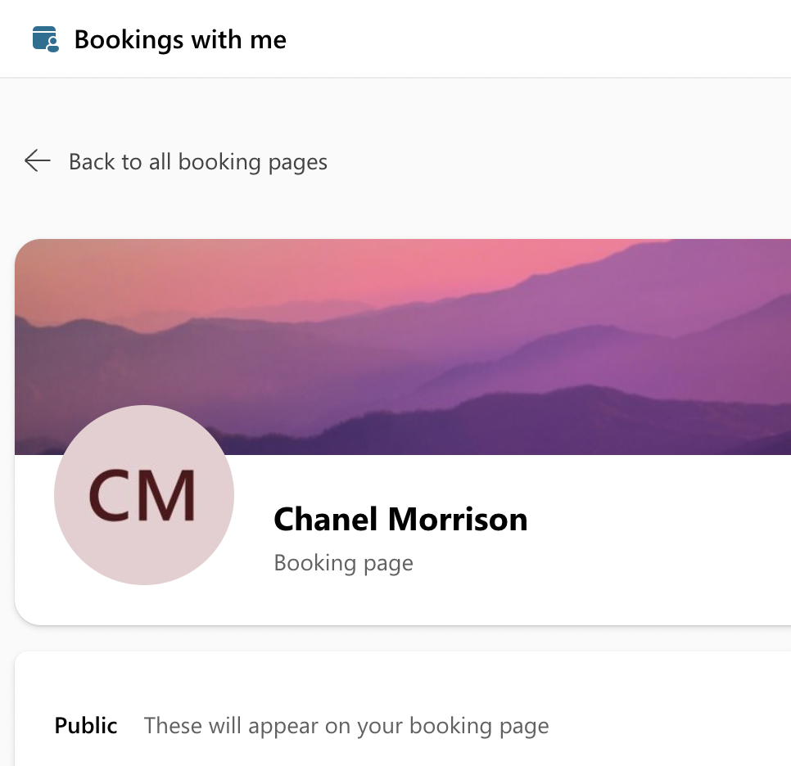
Bookings With Me
Available on the Outlook for the Web only
Bookings with me is only for 1:1 meetings
Bookings with me is linked to your personal Outlook calendar
Notes:
Chanel:
Bookings with me in Outlook helps you to schedule meetings between you and others through using mutual calendar availability and taking into account your specific meeting preferences. It is important to note that this feature is only available on the Outlook for the Web. This means you cannot use Bookings with me directly through the app. This feature also only works for 1 on 1 meetings. To access your booking with me page, simply navigate to your Outlook calendar, and select the Go to my booking page.

Slide 37
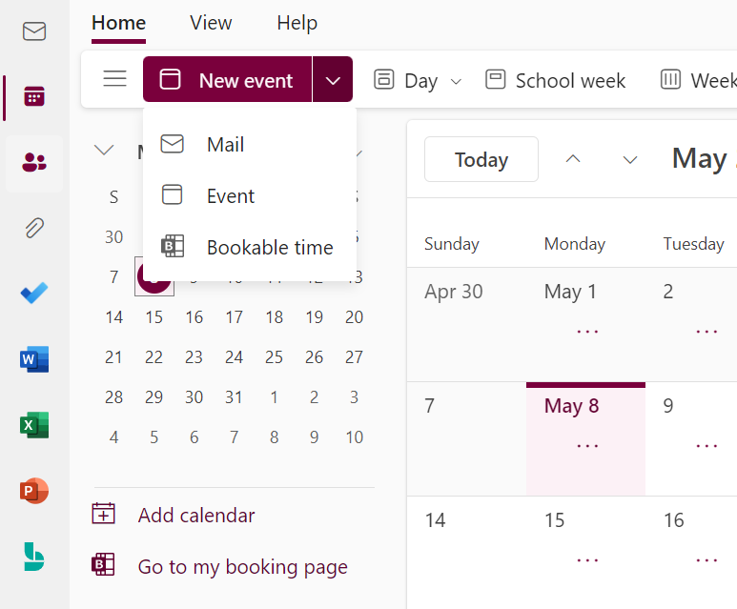
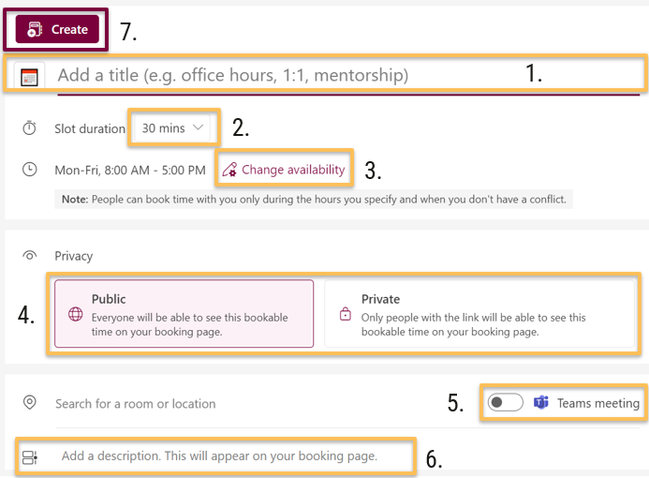
Creating and Managing a Bookings With Me schedule
2.
1.
Notes:
Chanel:
Now I will take you through the steps on how to use this feature. The first step is to open up your Outlook calendar on the web, then next you will need to select the downwards arrow located besides New event. You must then click on Bookable time from the drop-down menu which will then open your bookings with me schedule assistant.
You can begin by entering in a meeting title, then select the time duration (as you can see it shows 30 minutes here), the date from which you are available, the privacy settings (do you want this meeting to be public or private), the location (and if you see here, you can automatically schedule this as a Teams meeting), and finally a description of what the meeting will entail. Once you are finished entering in all of this information, you can select Create at the top and it will then schedule your meeting.

Slide 38
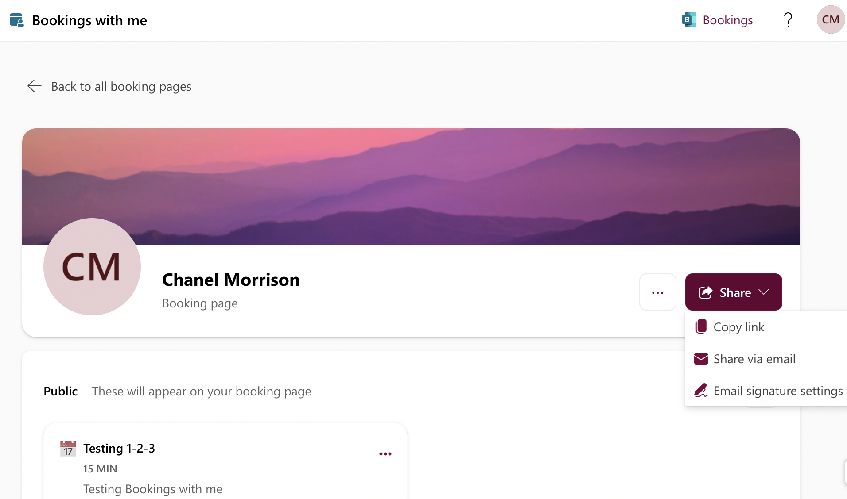
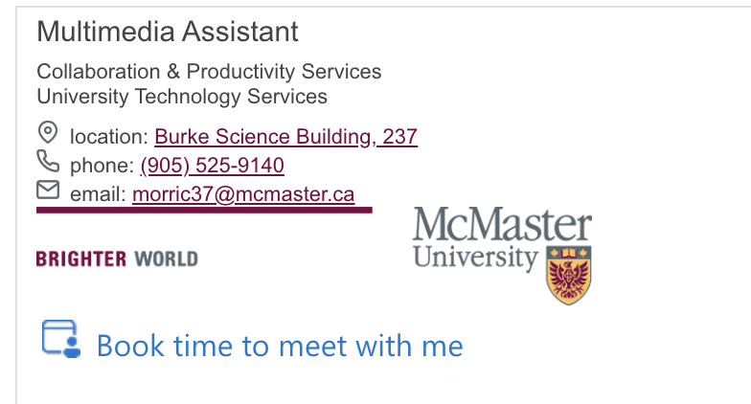
Your Bookings With Me Page
Sharing options:
Copy Link
Share via Email
Email Signature Settings
Notes:
Chanel:
If you are interested in sharing your bookings with me page, you can do so in 3 ways. You can do so by either sending a link that will direct others to your page, by sharing it via an email, or by making it visible in your email signature which can be accessed also when you send an email.

Slide 39
Discover & Learn

Slide 40
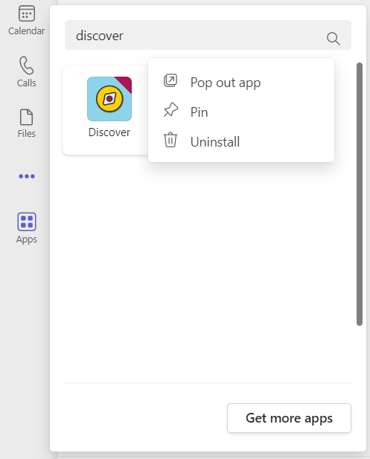
Discover & Learn
You can access Discover & Learn on Teams
Discover & Learn
For easy access, Pin the site
Click on the ellipses (…) in Teams
Type discover and search
Right click on the Discover Icon, and select Pin
Notes:
All updated information about M365 apps, 5 minute article, have a coffee break just come here and go through the udpate

Slide 41
Support and Community of Practice

Slide 42
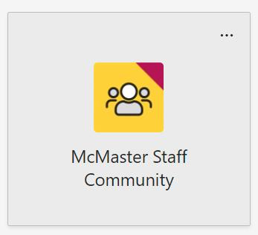
Support and Community of Practice
You can find assistance by asking questions in the Staff Community of Practice
You can book consultations/training with Christa
Notes:
The support and Community of practice offers latest information about updates. You can also ask questions outside of working hours here to get quick solutions. Make sure you add this channel on teams

Slide 43
Booking consultations

Slide 44
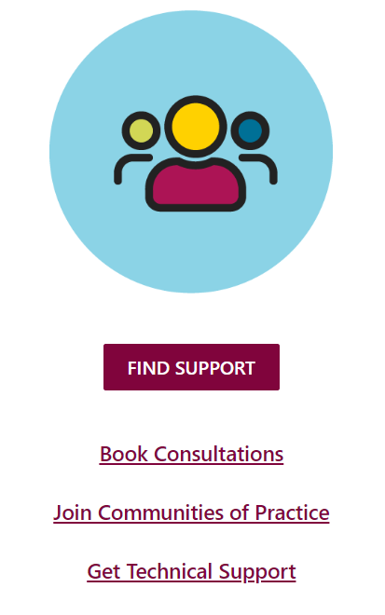
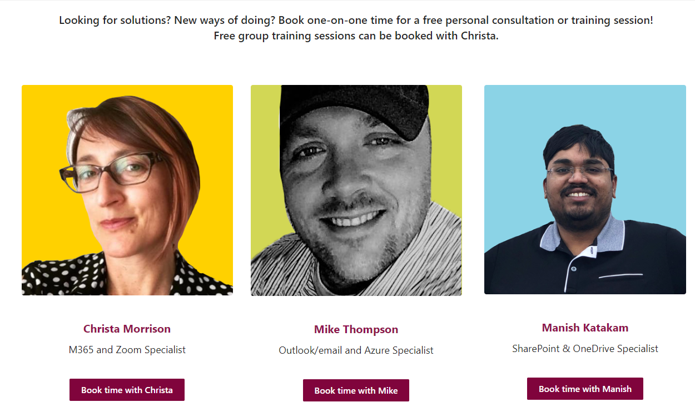
Booking consultations
You can now book consultations with Christa on Discover & Learn
Notes:
They can book meeting from 10 mins to 1 hour
Can book for any questions or even a session

Slide 45
Q&A

